Slide 1

Multilingual Sentiment Analysis on Product Reviews and Recommendations
by
S. Mastan Vali
Roll No. 204G1A0555
D. Abhiram
Roll No. 204G1A0502
A. Annapurna
Roll No. 204G1A0513
G. Amrutha
Roll No. 204G1A0510
Under the guidance of
Mrs. M. Soumya M. Tech( Ph. D)
Assistant Professor
Department of Computer Science and Engineering
Srinivasa Ramanujan Institute of Technology
(Autonomous)
2023 - 2024

Slide 2

Contents
Review-0 Comments
Abstract
Problem statement
Objectives of Project
Literature survey for first objective
Objective-1(Design & Implementation
Literature survey for second objective
Objective-2 (Design & Implementation)
Proposed Work -(Methods to be followed for proposed system)
References
GitHub Link

Slide 3
Review-0 Comments
Need to know about Technologies
Machine learning algorithms
Flask
Python
Django
SQL
2. Designing of Website
As, we have mentioned in our 0th review, we are planning to build an e-commerce website with major features what a normal e-site provides. But we try to reduce complexities what a normal site faces.

Slide 4
Abstract
In the modern digital landscape, online product reviews play a crucial role in shaping consumer opinions and purchasing behaviors. Our Project digs into the realm of multilingual sentiment analysis applied to product reviews, with a special emphasis on generating insightful recommendations. With an increasingly diverse customer base, understanding sentiments across different languages becomes essential for businesses seeking to provide tailored and relevant experiences.
Additionally, we extend our analysis to provide intelligent recommendations based on the sentiment patterns identified. By harnessing the power of multilingual sentiment analysis and recommendation systems, businesses can gain profound insights into customer preferences, fine-tune their products and services, and deliver a more personalized user experience.

Slide 5
Problem Statement
In the modern e-commerce landscape, analyzing sentiments across multiple languages in product reviews and leveraging the insights to offer personalized recommendations remains a critical challenge.
We need a smart solution that can fill this gap and provide businesses with useful insights to better engage customers and in strategic decision making.

Slide 6
Objectives of Project
Research Objective 1: Create a multilingual sentiment analysis model capable of analyzing sentiments expressed in product reviews across different languages.
Research Objective 2: Design and implement a recommendation system that utilizes the sentiment analysis results to provide personalized product recommendations to users.

Slide 7
Literature survey for first objective
The proposed model combines a sentiment dictionary with a convolutional neural network (CNN) and a Long Short- Term Memory (LSTM) network. The sentiment dictionary is used to extract sentiment scores for individual words, the CNN is used to capture local features of the text, and the LSTM is used to capture long-term dependencies in the text. The model is trained on a dataset of tweets in English and Hindi. [1]
It is a good starting point for developing a multilingual sentiment analysis system for the first objective. The model is simple to implement and it can achieve good performance on a variety of tasks. However, the model can be improved by using a better sentiment dictionary and a more powerful machine learning system.

Slide 8
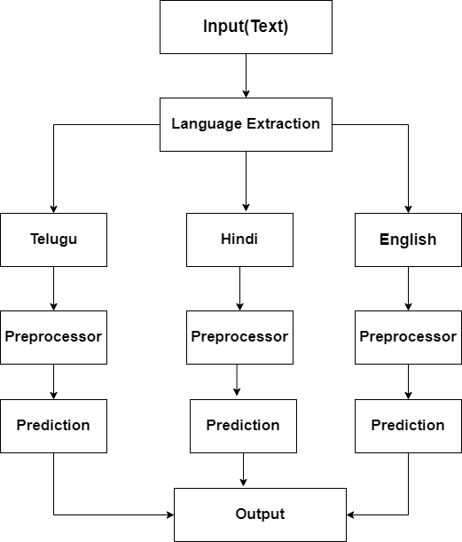
Design and implementation of first objective
Fig 1: Multilingual Sentiment Analysis

Slide 9
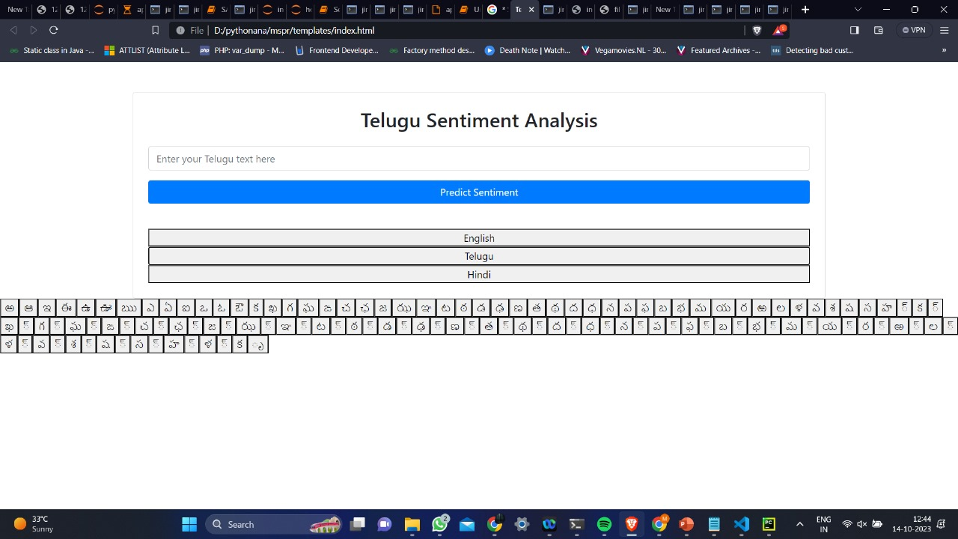
Design and implementation of first objective
Fig 2: Website

Slide 10
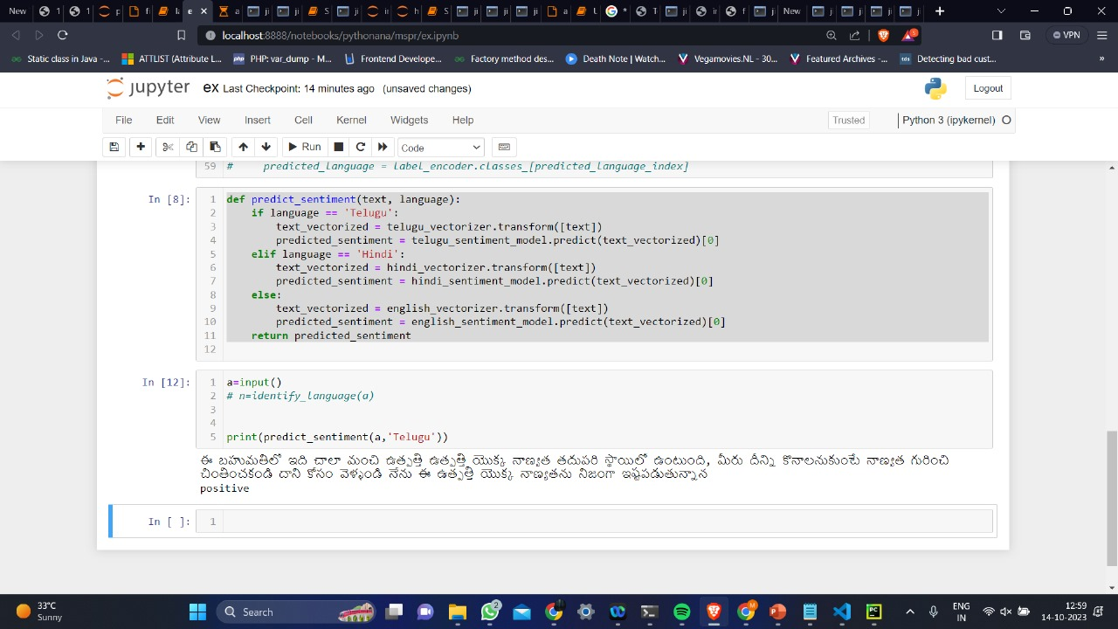
Design and implementation of first objective
Fig 3: Output for Telugu language

Slide 11
Literature survey for second objective
The proposed model is a personalized recommendation system that uses sentiment analysis of product reviews. The system first identifies the purchase criteria of each user. Then, it analyzes the sentiment of product reviews for products that match the user's purchase criteria. Finally, it recommends products to the user that have positive sentiment reviews.[2]
This model is a good starting point for developing a recommendation system. But, The algorithm used in the paper is a simple algorithm that is not very accurate. And their model uses purchase criteria to make recommendations but we are only going with sentiments of the reviews.

Slide 12
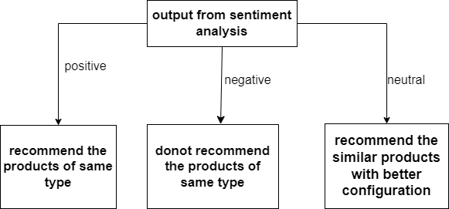
Design and implementation of second objective
Fig 4: Recommendation System

Slide 13
Proposed System
Our system will develop language-specific sentiment analysis models using deep learning techniques such as CNNs and RNNs. It will identify the language of input text, apply the relevant model for sentiment classification, and aggregate results for a comprehensive multilingual sentiment assessment.
Our system integrates sentiment analysis results into a recommendation engine that suggests products based on positive sentiments and offers solutions for negative sentiments.

Slide 14
References
[1] Prof. Annapoorna B R, Akhil Rautela, Anurag Verma, Aditya Kumar Mishra, Dishant Kumawat, “Hybrid Deep Learning Model for Multilingual Sentiment Analysis”, 2022, International Research Journal of Engineering and Technology (IRJET) Volume: 09, Issue: 05, May 2022, 144 - 150
[2] Wu Guanchen, Minkyu Kim, Hoekyung Jung, “Personal customized recommendation system reflecting purchase criteria and product reviews sentiment analysis ” Int J Elec & Comp Eng, Vol. 11, No. 3, June 2021 : 2399 - 2406

Slide 15
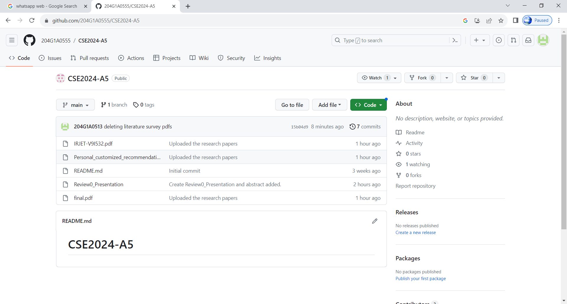
Git Hub Dashboards of each student
https://github.com/204G1A0555/CSE2024-A5

Slide 16
Any Queries?

